Slide 1

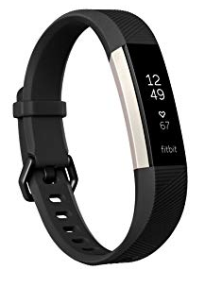
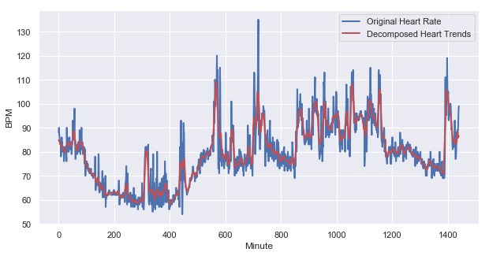
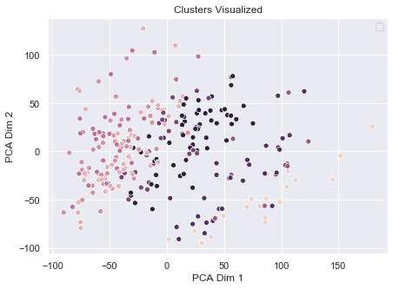
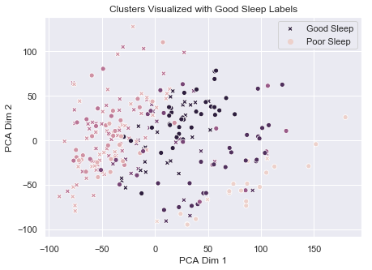
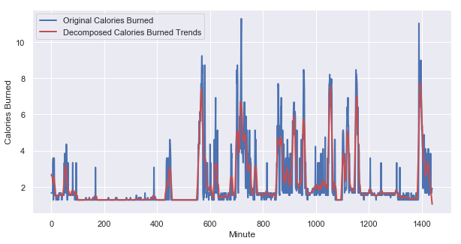
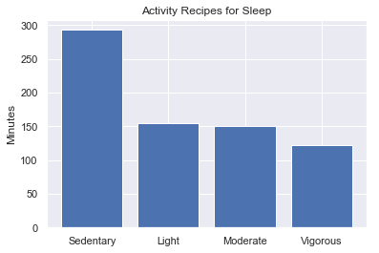
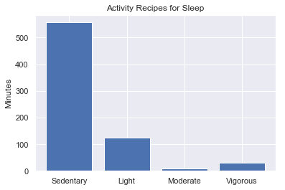
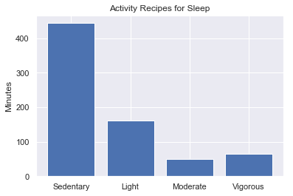
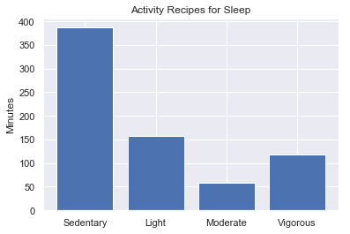
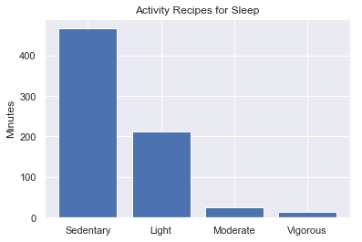
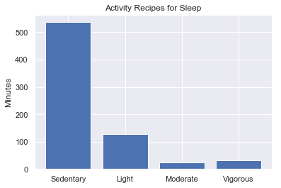
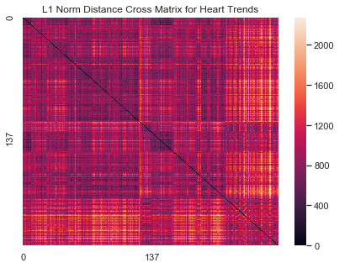
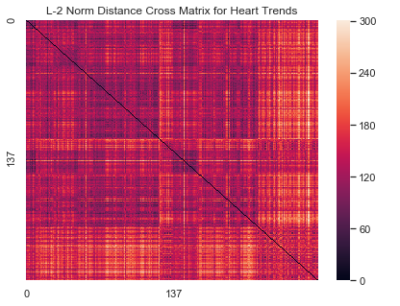
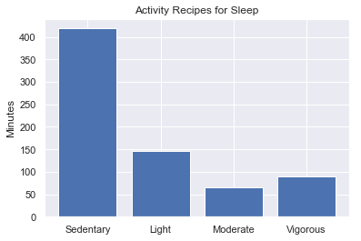
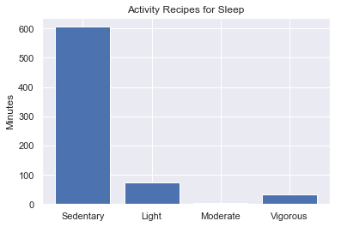
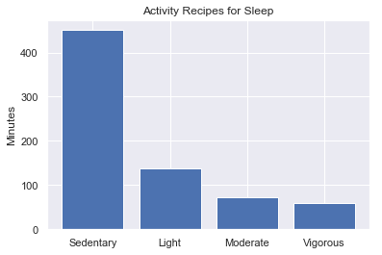
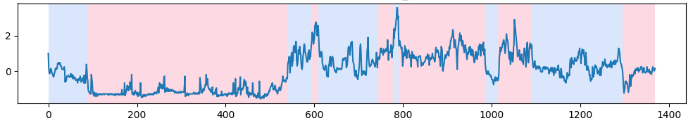
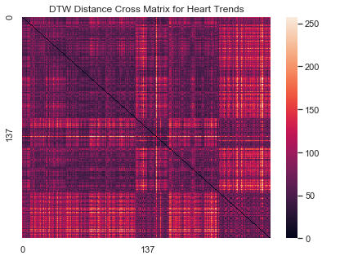
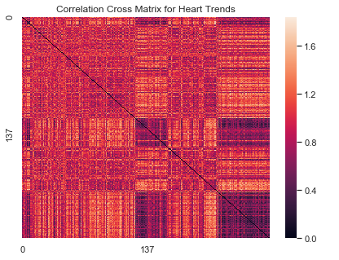
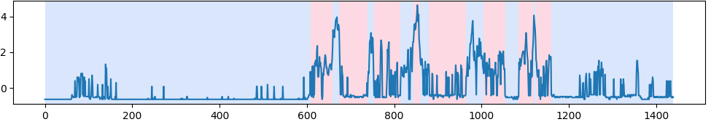
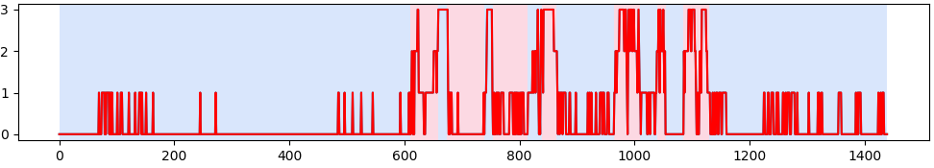
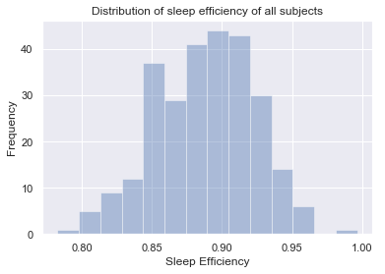
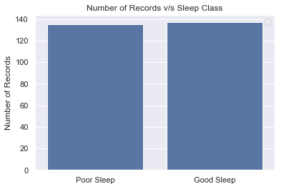
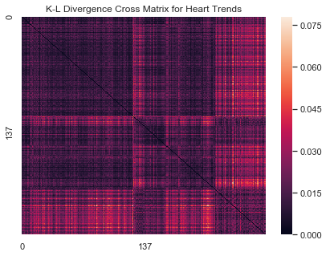
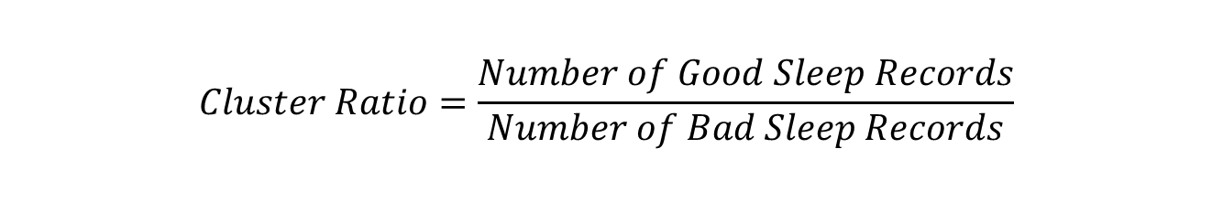
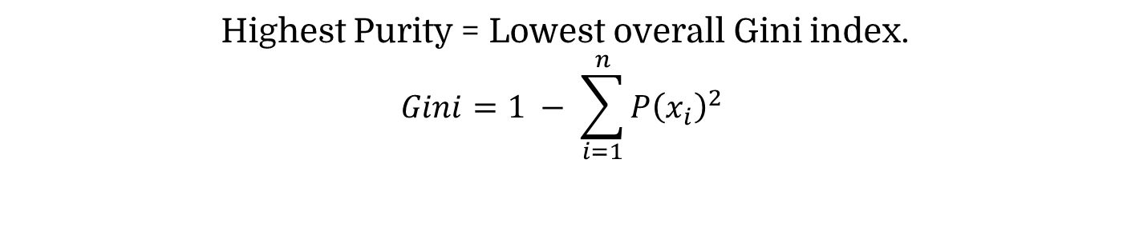
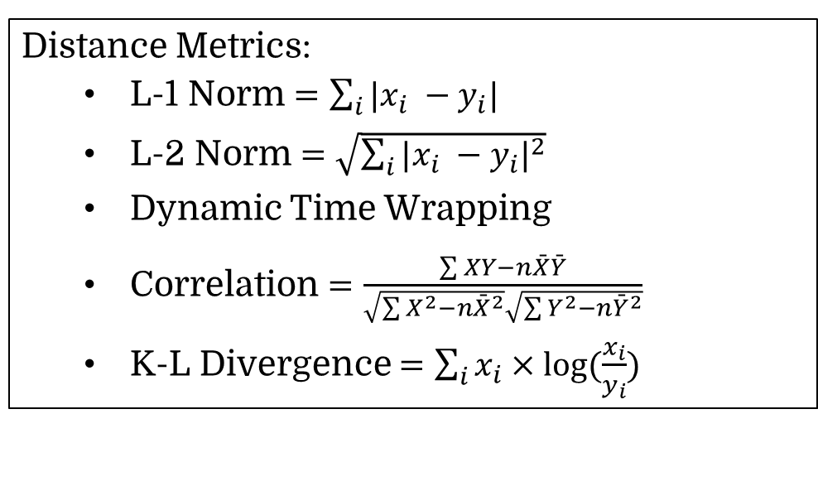
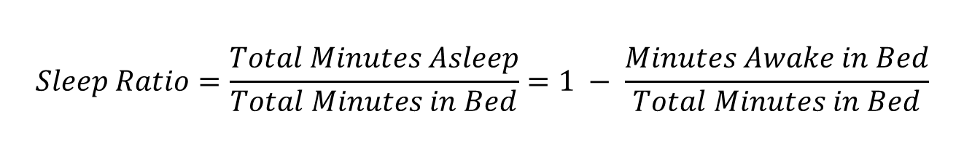
Activity Recipes for High Sleep Efficiency
using Wearable Device Data
Saksham Goel | goelx029 | 5138568
Mentor: Meghna Singh, Professor: Jaideep Srivastava
Department of Computer Science, University of Minnesota Twin Cities
Abstract
Methodology
Results
My project tries to address whether day to day activities affect quality of sleep, and if there are activity recipes that can be learned for making recommendations to users to ensure good sleep. This is achieved by applying clustering techniques over intraday time series data collected from wearable devices to extract activity recipes for high sleep efficiency, which will then be supplied to an activity recommendation engine. Various distance metrics are evaluated for their effectiveness in processing health time series data.
Data Collection: 4 people over a time period of 4 months.
Data Cleaning: Removing NaN values using means found in hourly segments corresponding to each user.
Distance Metric | Purity of Clustering | Avg. Purity of Activity Recipe Clusters
L-1 Norm | 0.5473 | 2.13
L-2 Norm | 0.5848 | 2.34
DTW | 0.6372 | 2.59
Correlation | 0.6516 | 3.12
K-L Divergence | 0.7006 | 4.18
Fitbit Web API
Feature Extraction: Smoothing using a seasonal decomposition of moving window length 10 minutes
Data Collection Script
FITBIT DB
Table: Comparison of different distance metric functions over clustering purity
Intraday Data
(Heart, Sleep, Activity, Steps)
LAB DB
Data Validation and Cleaning
Feature Extraction
Figure: Trends extracted from the raw heart rate data
Introduction
Figure: Cluster Assignments of heart rate trends using K-L Divergence
Figure: Cluster Purity of Sleep Labels using K-L Divergence over heart rate trends
Significance: Inadequate sleep negatively affects mental and physical well-being and exacerbates health problems such as diabetes, depression, cancer and obesity.
Project Objective:
Extract actionable knowledge of activity recipes for high sleep efficiency using low cost, ubiquitous, low fidelity data for health and wellness from wearable devices like Fitbit.
Supply activity recipes learned to an Activity Recommendation Engine
Tasks:
Heart rate data to cluster biologically similar people
K-Means Clustering to find similarity among good sleep instances and learn best activity recipes for high sleep efficiency.
Optimal number of clusters
Highest Purity = Lowest overall Gini index.
$$Gini=1 − \sum_{i=1}^{n}{P{\left(x_{i}\right)}^{2}}$$
K-Means Clustering
Figure: Trends extracted from the raw calories rate data
Distance Metrics:
L-1 Norm $=\sum_{i}{|x_{i} −y_{i}|}$
L-2 Norm $=\sqrt{\sum_{i}{{|x_{i} −y_{i}|}^{2}}}$
Dynamic Time Wrapping
Correlation $=\frac{\sum{XY−n\bar{X}\bar{Y}}}{\sqrt{\sum{X^{2}−n{\bar{X}}^{2}}}\sqrt{\sum{Y^{2}−n{\bar{Y}}^{2}}}}$
K-L Divergence $=\sum_{i}{x_{i}×log⁡(\frac{x_{i}}{y_{i}})}$
Sub Clusters Clustering
K-Means on each of the clusters individually.
Features: Activity level summaries of the day.
Similar distance metric
$$Sleep Ratio=\frac{Total Minutes Asleep}{Total Minutes in Bed}=1 − \frac{Minutes Awake in Bed}{Total Minutes in Bed}$$
Figure: Activity Recipes for good sleep found using K-L Divergence distance metric
Activity Recommendation
Good Sleep Activity Recipes Extraction
Conclusions
$$Cluster Ratio=\frac{Number of Good Sleep Records}{Number of Bad Sleep Records}$$
Good sleep nights have similar preceding daily activities, while poor sleep can vary
Clustering over heart rate lead to clusters containing varied activity level helping learn myriad different activities from same cluster
Among the distance metrics, K-L divergence performs best in finding the purest cluster w.r.t sleep efficiency and produces meaningful and varied activity recipes
Good sleep = Sleep Ratio ≥ 0.90
Good Sub Clusters = Cluster Ratio ≥ 2
Figure: Comparison of different Distance Metrics used for Clustering using Distance Cross Matrix over Heart rate and Calories Time Series data. The x-axis and y-axis represent each record in ordered form from good sleep to poor sleep. Because of this we expect to see a different color patch between the quadrants across the top down and bottom up diagonal
Figure: Distribution of the sleep efficiency scores in the dataset
Figure: Number of records for Good v/s Poor sleep

